Slide 1

Driver’s drowsiness detection and warning system
P. Amogh 19H51A0561
G. Keerthi 19H51A0572
K. Sri Harsha 19H51A0573
K. Vamshi Krishna 19H51A0574
Under the guidance of
Major Dr.V.A Narayana

Slide 2
CONTENTS
Problem Statement
Motivation for the Project
Objective
Scope and Limitations
Existing Solutions
Disadvantages of Existing Solutions
Proposed model
Flow chart
Results
Software and Hardware specifications
Advantages
and Disadvantages
Conclusion
References

Slide 3
Problem Statement
Many of the road accidents will occur due to drowsiness of the driver.
Driver fatigue is a significant factor in a large number of vehicle accidents.
Drowsiness can be detected by monitoring the driver through continuous video stream with a mobile or camera.
The general objective is to create a model that will indicate whether a person is feeling drowsy or not.

Slide 4
The model takes image for every second and checks for eye blinking and mouth opening measures which helps in calculating the time for eye closed by perclos algorithm and the mouth aspect ratio.
If the blinking is high with eyes is closed for a certain amount of time and the mouth aspect ratio is higher then usual due to yawning then it will indicate the driver through a sound.

Slide 5
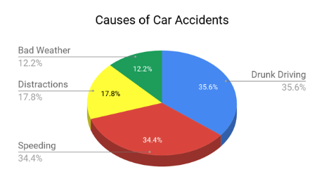
MOTIVATION FOR THE PROJECT
Drowsiness of the drivers is one of the key issues for majority of road accidents.
Drowsiness threatens the road safety and causes severe injuries sometimes, resulting in fatality of the victim and economical losses.
Performance of the driver gradually deteriorates owing to drowsiness.

Slide 6
Drowsiness implies feeling lethargic, lack of concentration, tired eyes of the drivers while driving vehicles. Most of the accidents happen in India due to the lack of concentration of the driver.
To prevent this type of incidents, it is required to monitor driver’s alertness continuously and when it detects drowsiness, the driver should be alerted. Through this we can reduce significant number of accidents and can save lives of people.

Slide 7
OBJECTIVES
The objective of this project is :
To develop a system that is able to detect drowsiness of a driver.
To Improve the accuracy of existing systems by monitoring both eyes and mouth to calculate eye aspect ratio and distance between lips and warn the driver if the driver is drowsy or yawning.

Slide 8
SCOPE AND LIMITATIONS
The driver drowsiness detection system provides the similar functionality like the existing models but with better accuracy and functionality.
Also, it alerts the user on reaching a certain saturation point of the drowsiness measure.
It may not work without proper lightning.
There should not be any reflecting object behind the driver.
It may not work for people with dark skin

Slide 9
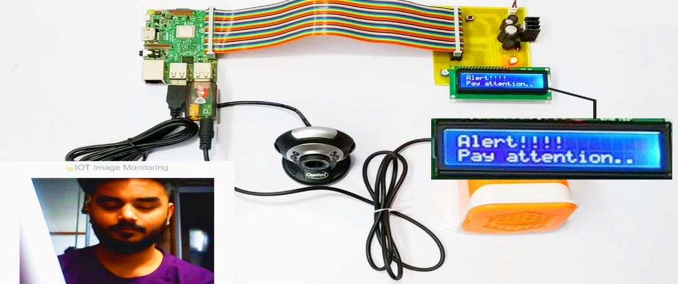
EXISTING SOLUTIONS
IoT-Based Smart Alert System for Drowsy Driver Detection:
This model has a camera monitoring the driver’s eye blinking, eye closure, face detection, head posture, etc.
with face landmark algorithm and Euclidean distance in the behavioral-based approach.
In addition to monitoring the intensity of the collisions impacts, it is also keeps the records of the location for taking supportive action.

Slide 10
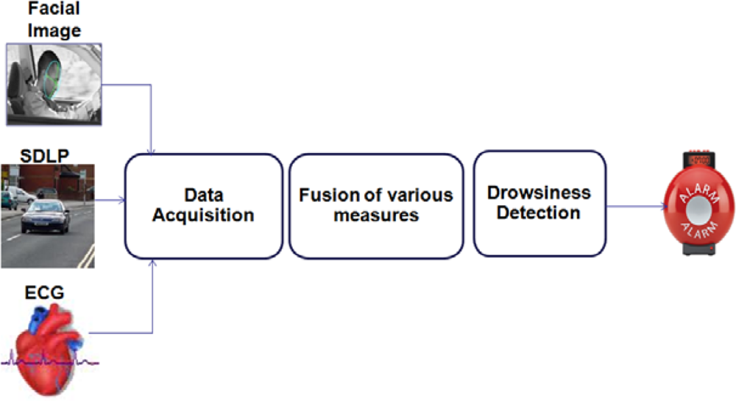
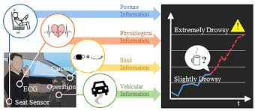
Karolinska Sleepiness Scale Detection based on Sensors:
This model evaluates the level of drowsiness based on the driver’s personal estimation and many tools that have been used to translate this rating to a measure of driver drowsiness.
The KSS ratings of drivers for every 5 min and used it as a reference to the EoG signal collected.
It has a nine-point scale that has verbal anchors for each step.

Slide 11
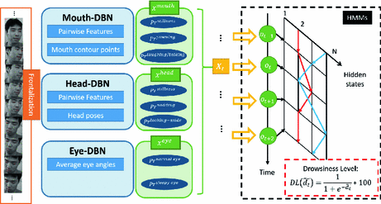
Dynamic Bayesian Network Model:
This model is done in a probabilistic way using various physiological and contextual information.
Electroencephalogram (EEG), Electromyogram (EMG), and respiration signals were simultaneously recorded by wearable sensors and sent to computer by Bluetooth during the real driving.
From these physiological information, fatigue likelihood can be achieved using kernel distribution estimate at different time sections.

Slide 12
Disadvantages of Existing solutions
Lower accuracy due to features dependency chain.
Difficult to see significant differences between tired and alert drivers.
Road geometry influences the results.
Very high sensitivity to changes in illumination conditions.
Templates becoming mismatched when global minimum fit cannot be found for the model.

Slide 13
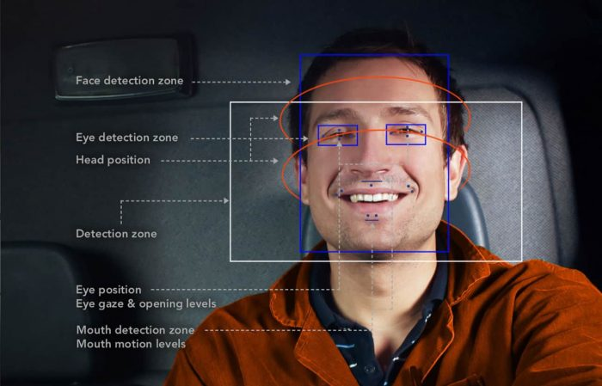
PROPOSED MODEL
The Proposed Drowsiness detection system identifies key attributes of drowsiness and triggers an alert when someone is drowsy before it is too late.
For our training and test data, we used the Real-time Drowsiness Dataset specifically for detecting multi-stage drowsiness.
The end goal is to detect not only extreme and visible cases of drowsiness but allow our system to detect softer signals of drowsiness as well.

Slide 14
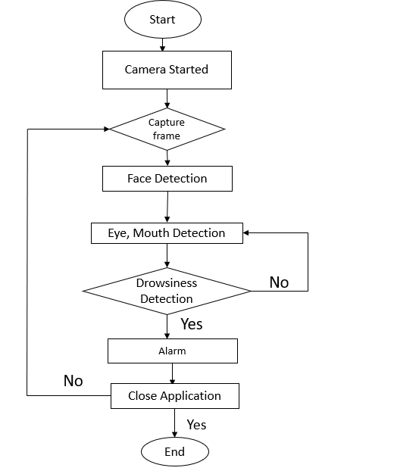
FLOW CHART

Slide 15
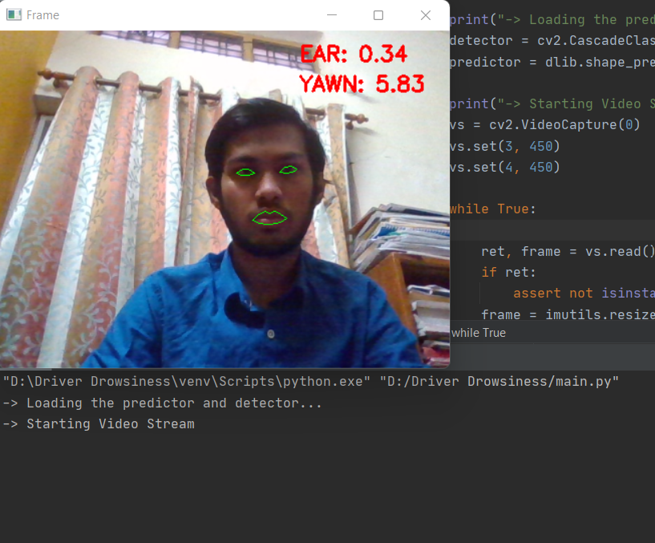
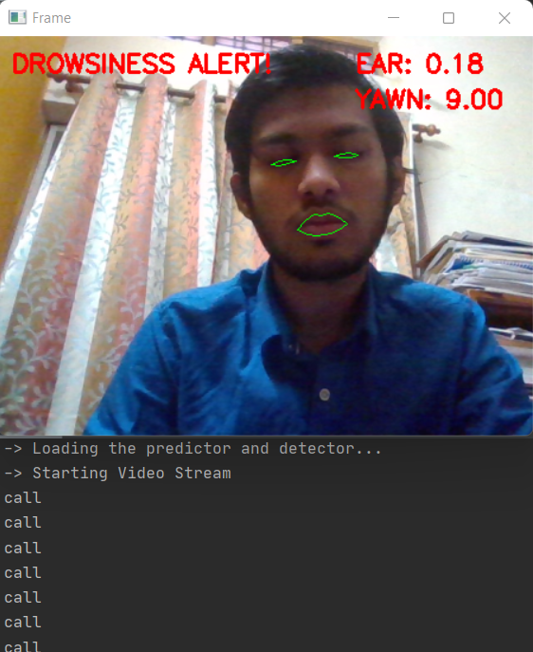
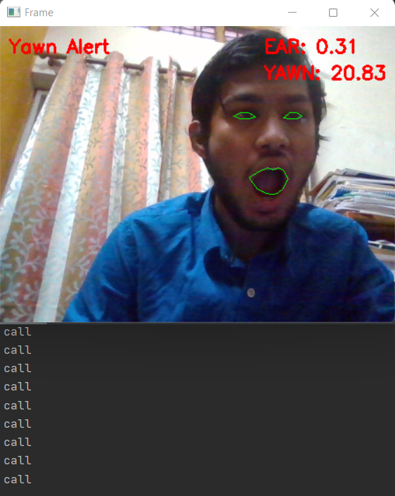
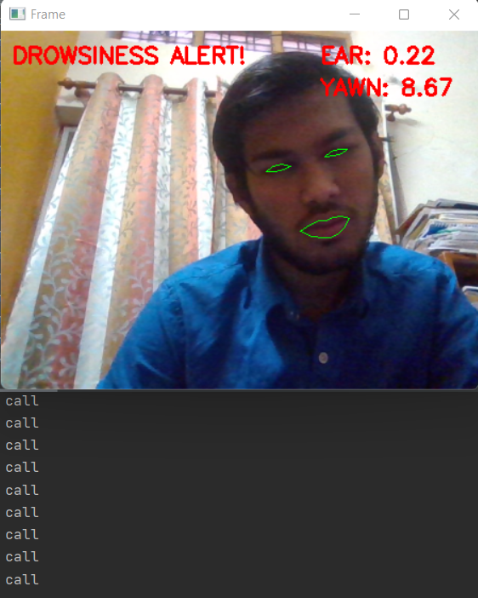
RESULTS
A Testcase Where the driver is neither drowsy nor yawning
A Testcase Where the driver is Drowsy
A Testcase Where the driver is yawning
A Testcase Where the Driver is Drowsy but at an angle

Slide 16
SOFTWARE AND HARDWARE SPECIFICATIONS
Software
Python3,pycharm
Open cv
Libraries like imutils,Scipy,face recognition,numpy,argparse,thread,dlib,wincom
Hardware
Camera
System

Slide 17
ADVANTAGES and DISADVANTAGES
ADVANTAGES
Accurate and very fast.
Low cost compared to other models.
Has face detection module that can be used for camera focus control.
Record maintenance.
DISADVANTAGES
Has few false positions, needs learning.
Interpersonal accuracy dependent on external conditions.

Slide 18
CONCLUSIONS
The drowsiness detection system developed is capable of detecting drowsiness in a rapid manner.
The system which can differentiate normal eye blink and drowsiness in addition to yawning which can prevent the driver from entering the state of sleepiness while driving.
The system works well even in case of drivers wearing spectacles and under low light conditions also.

Slide 19
During the monitoring, the system is able to decide if the eyes are opened or closed.
When the eyes have been closed for about four to six seconds or yawn, the alarm beeps to alert the driver.
By doing this many accidents will reduced and provides safe life to the driver and vehicle safety.

Slide 20
REFERENCES
Detecting Driver Drowsiness Based on Sensors: A Review (nih.gov)
IoT-Based Smart Alert System for Drowsy Driver Detection (hindawi.com)
Drowsiness Detection with Machine Learning | by Grant Zhong | Towards Data Science

Slide 21
Thank You

